Slide 1
EAS&Ensor
From requirements to deployment
(Enterprise architect and what is the purpose)

Slide 2
Agenda
Why?
Steps in Enterprise architect
What is the purpose of those steps?
Forward and reverse.

Slide 3
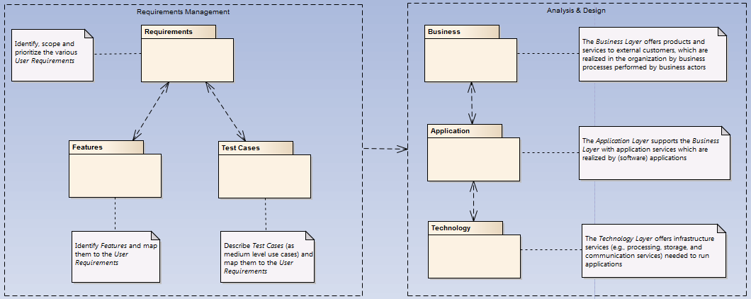
Used to be process (flaws and potholes detected).

Slide 4
Process flow from requirements to tests
Requirements
Analysis & Design
Requirements
Business
UML Activity
Archimate
Business
Application
Features
Use Cases
Archimate
Application
UML Sequence
Technology
Test guidance
Archimate
Technology
Test Cases
Test Scenarios

Slide 5
Required process
Requirements
Analysis & Design
Requirements
Business
UML Activity
Archimate
Business
Application
Features
Use Cases
Archimate
Application
UML Sequence
Technology
Test guidance
Archimate
Technology
Test Cases
Test Scenarios

Slide 6
Supporting process (flaw detection)
Requirements
Analysis & Design
Requirements
Business
UML Activity
Archimate
Business
Application
Features
Use Cases
Archimate
Application
UML Sequence
Technology
Test guidance
Archimate
Technology
Test Cases
Test Scenarios

Slide 7
Change. Dare to change. Dare to throw away.
What you design is not concrete.
We can change it whenever need it.
Nothing is sacred. Everything can and probably will change.

Slide 8
Steps towards.
Requirements: What is the need?
Feature: Is an answer on the requirement. How to find a solution for the requirement.
Use Case: Happy flow with alternative flows.
Test Case: Going through all possibilities to challenge the use cases.

Slide 9
Requirements
If it is not clear enough to comprehend try to split it up in edible pieces.

Slide 10
What makes a good use case?
A use case describes the way your system behaves to meet a requirement.
A use case is something that provides some measurable result to the user or an external system.
Any piece of system behavior that meets this simple test is likely to be a good candidate for a use case.

Slide 11
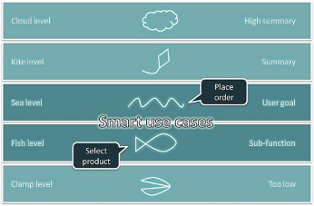
Sea level of a use case

Slide 12
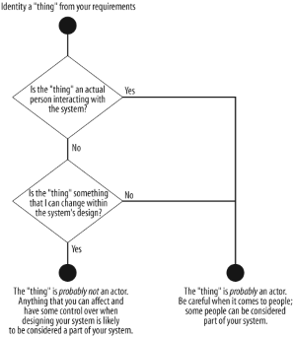
How to define an actor?

Slide 13
What is an actor?
Actors don't have to be actual people. While an actor might be a person, it could also be a third party's system, such as in a business-to-business (B2B) application. Think of an actor as a black box: you cannot change an actor and you are not interested in how it works, but it must interact with your system.

Slide 14
We strive for an evolutionary architecture.

Slide 15
Key Rules
Technology independence.
Tests first.
Growing.

Slide 16
To start with our project and work in an ecosystem that gives a good base for our test driven development we provide requirements for inclusion in our test harness. As we go out of the growing principle in our approach to development we strive for the minimum requirements (just enough to be able to test and be sure) needed.
The test harness will evolve to a walking skeleton as we called it. The skeleton is an implementation of the thinnest possible slice of real functionality that we can automatically build, test and deploy end-to-end.

Slide 17
If it isn't tested, it's broken.

Slide 18
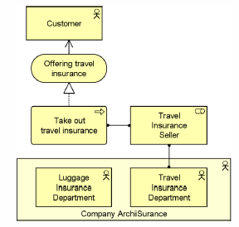




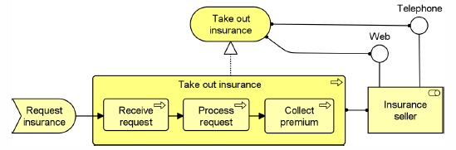


business

Slide 19
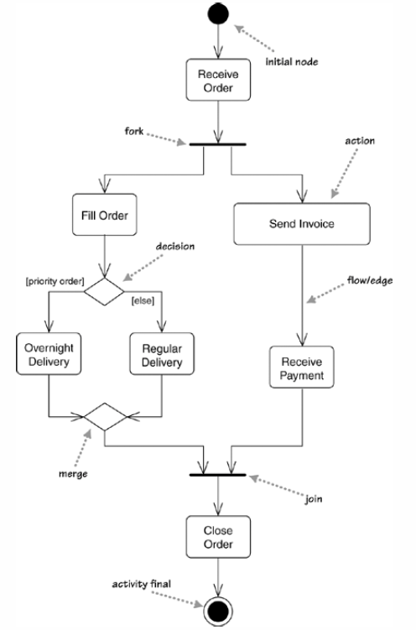
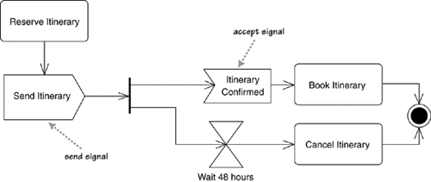
UML activity diagrams

Slide 20
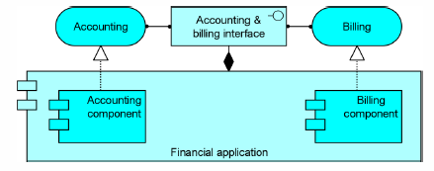




application

Slide 21

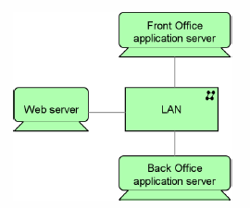




technology

